Slide 1
IDS 462 Lecture 2
Segmentation by Cluster Analysis
And An Introduction To Macros

Slide 2
Review & Preview
Factor Analysis segments the variables (or columns)
  Segment simply means form groups that are more alike than they are different
We also need to be able to segment individuals (rows)
  Individuals is a technical term for the rows of the database (can be people, zip codes, business, stocks, etc.)
This is an important function in the world of business, particularly marketing
In the business world, segmentation refers to the segmentation of the individuals, so I will follow that language for the remainder of this document

Slide 3
Segmentation Methods
Tree Methods
  Based on a dependent variable
    CHAID
    CART
  Idea is to find segments that have above average spending on your product, etc.
  More on this later when we study models for binary dependent variables
Clustering Methods
  Not based on a dependent variable
  Although it can be included in the data, it does not get any special treatment
  Two basic types
    Hierarchical clustering
    Disjoint clustering (frequently referred to as K-means clustering)

Slide 4
Hierarchical Clustering
Used on smaller datasets (I.e. market research work)
Answer questions like ‘What segments of brands exist in the Beer category’
Puts closest individuals into a segment and then builds up to a single segment (or other way around)

Slide 5
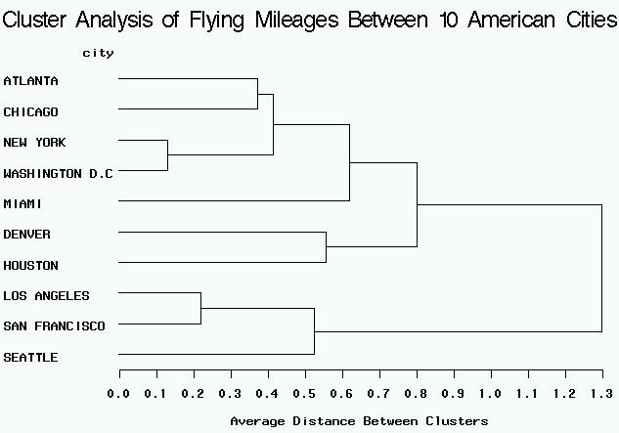
Hierarchical Clustering Example

Slide 6
K-Means Clustering– What and How
Generally appropriate when the number of individuals is larger than a few hundred
This is what we will concentrate on
How does it work?
Randomly select a small number of points in the data set to use as seeds, or beginning cluster centers
For first individual in dataset, compute the distance to each seed
Assign individual to closest seed
Repeat for all individuals

Slide 7
K-Means Clustering– How Contd.
After assigning all individuals to each of the seeds, compute the center of each cluster
  If only working in two dimensions, then this would be the average of the x-coordinates and y-coordinates for all the assigned members of the cluster
  Generalizes to n-space

Slide 8
K-Means Clustering– How Contd.
Repeat the process on pages 5-6 using new centers
Continue until no individual changes cluster membership
  Different stopping rules are available
See pages 1 to 7 of cluster_analysis[1] in the Lecture 2 folder on blackboard
Remaining pages of that document discuss an alternative to cluster analysis, called Latent Class analysis, that has many advantages, but is not widely available.

Slide 9
K-Means– Issues
Final cluster solution (e.g. segments) is sensitive to
  Number of seeds
  Position of initial random seeds selected
  Variables Used
What to do?
  Use Rotated Factor Scores for Variables
  Evaluate using two criterion
    Pseudo F-statistic
    Size of smallest cluster

Slide 10
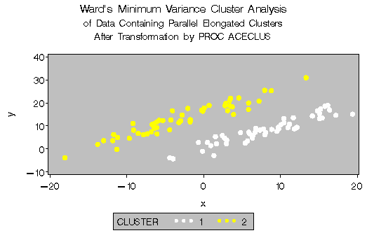
Use of Factor Scores vs. Variables
Using correlated variables in your cluster analysis can give elongated segments
These can be difficult to detect, interpret & explain

Slide 11
Factor Scores Are Uncorrelated
By definition, the scores from a factor analysis are orthogonal, or uncorrelated
  Each observation in the data set can be scored for each factor
  This was discussed in Lecture 1, but we did not do it as part of the last assignment
I recommend using the factor scores as the variables for the cluster analysis
When the clustering is complete, we then describe the segments in terms of a few raw variables (I.e. income, age, home ownership, race) that were important for each factor

Slide 12
Not Everyone Uses Factor Scores
This method is only appropriate if you can score a new observation with the factor scores (if need be) so that the observation can be placed in the n-space and then subsequently assigned to a cluster based on distance to the center of the cluster
Some authors don’t like using factor scores even if this is possible
  See paragraph near bottom of pg 329 of text

Slide 13
Pseudo F-Statistic
For each cluster, the variation with the cluster is calculated, as is the variation between the clusters
The ratio of the two is computed a la the F-statistic
  Side point: Why should we not evaluate the statistical significance of this statistic?
A segmentation with a larger pseudo F is generally considered better (all other things being equal!)
  Because the higher F value means that the segments are more tightly concentrated around their center

Slide 14
Pseudo F and Number of Clusters
Generally, we expect that as the number of clusters goes up the pseudo F-statistic will also increase
  Because easier to get tighter distribution with more segments
So if we re-run with a larger number of initial seeds (say 6 instead of 5) and the F does not increase, then we PROBABLY have asked for too many segments

Slide 15
Pseudo F and Smallest Segment
The concept on the previous page must be balanced against the size of the smallest segment
  One small segment will have a very tight distribution around its center and therefore increase the Pseudo F
  The formation of such a segment is influenced by the position of the initial seeds, which are selected randomly
So, need to run cluster algorithm multiple times for a reasonable number of segments and examine distribution of pseudo F’s and size of smallest segment
This is where Macro language comes in!

Slide 16
SAS Macro Language
This is a powerful part of SAS
Can also be tricky
At it’s simplest, it merely stores key strokes
For example, if I have a set of variable names that I will be using repeatedly, I can store them in a macro variable name as a ‘short-hand’
Example follows

Slide 17
Macro Variable &OOH
libname teach "F:\School\IDS462";
data prefactor;
set teach.dmefzip (drop=adicode branchcd countycd countynm dmacode filetype msa multzip nielcode poffname rectype stateabr statecd);
run;
%let OOH= PRC3544 PRC4554 PRC5564;
proc means data=prefactor n nmiss;
var &OOH;
run;
proc univariate data=prefactor;
var &OOH;
run;

Slide 18
Rules for Macros
You cannot run a macro until you compile it
libname teach "F:\school\ids462";
%Macro Example (dsn, vars); /*Beginning of Macro Program*/;
proc sort data=&dsn out=temp;
by &vars;
run;
%Mend Example; /*End of Macro*/;
%Example (teach.dmefzip, zipcode); /*Invoke Macro*/;

Slide 19
Loops in Macros
%Macro SetLoop;
options mprint;
data temp;
set
%do i=1 %to 3;
p9.AnovaFile&i
%end;
;
run;
options nomprint;
%Mend SetLoop;
%SetLoop;
60 %Macro SetLoop;
61 options mprint;
62 data temp;
63 set
64 %do i=1 %to 3;
65 p9.AnovaFile&i
66 %end;
67 ;
68 run;
69 options nomprint;
70 %Mend SetLoop;
71 %SetLoop;
MPRINT(SETLOOP): data temp;
MPRINT(SETLOOP): set p9.AnovaFile1 p9.AnovaFile2 p9.AnovaFile3 ;
MPRINT(SETLOOP): run;
MPRINT(SETLOOP): options nomprint;

Slide 20
Back to Factor/Cluster
proc factor data=prefactor rotate=varimax nfactors=5 scree out=FactorScores;
var _numeric_;
title "Output Factor";
ods output OrthRotFactPat=FactorOutput;
run;
title;

Slide 21
Now Cluster On Factor Scores
proc fastclus data=FactorScores out=ClusterOut cluster=clus maxclusters=4
converge=0 maxiter=100 replace=random random=92765 /*strict=5*/;
ods output pseudofstat=fstat;
var factor1--factor5;
title1 "Initial Cluster Analysis";
run;
title1;

Slide 22
Analyze Results
proc means data=ClusterOut mean maxdec=0;
class clus;
var INCMINDX PRCRENT PRCUN18 PRC200K PRCWHTE;
title "Summary Statistics for 4 Clusters";
run;
proc summary data=ClusterOut nway;
class clus;
var INCMINDX PRCRENT PRCUN18 PRC200K PRCWHTE;
output out=ClusStats mean=;
run;
PROC EXPORT DATA=ClusStats
OUTFILE= "f:\school\IDS462\ClusStats.xls"
DBMS=EXCEL2000 REPLACE;
RUN;
proc summary data=ClusterOut nway;
var INCMINDX PRCRENT PRCUN18 PRC200K PRCWHTE;
output out=OverallStats mean=;
run;
PROC EXPORT DATA=OverallStats
OUTFILE= "f:\school\IDS462\OverallStats.xls"
DBMS=EXCEL2000 REPLACE;
RUN;

Slide 23
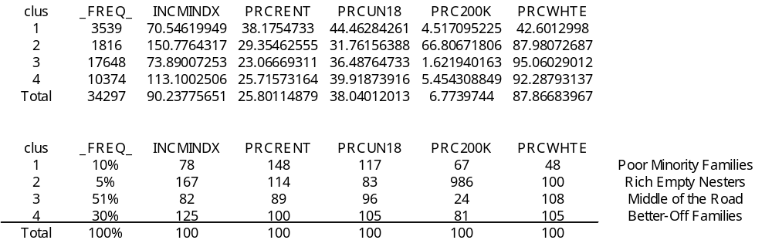
Analyze In Excel

Slide 24
How Deal With Sensitivities
As mentioned previously, however, this solution is sensitive to the number of clusters and the randomly selected starting points of the cluster
What to do?
We need to run 10 iterations of the 4 cluster solution, 10 iterations of the 5 cluster solution, etc and examine the affects on the final solutions
  Examine Pseudo-F and smallest cluster size
  Also look for consistency of solutions
This is accomplished with the program ClusterLoop2.sas so let’s take a look at it

Slide 25
ClusterLoop2.sas
Discuss Program
Run Program
Analyze Final Graph
Prepare to write memo

Slide 26
Question To Answer in Memo
Your boss want to know “What are the major demographic segments in America, based on Zip code data”?
Describe the segments in terms of summary statistics for demographic variables from the Zip code file

